Slide 1
Lecture 04
CSE 3213
Computer graphics
Drawing Elementary Figures

Slide 2
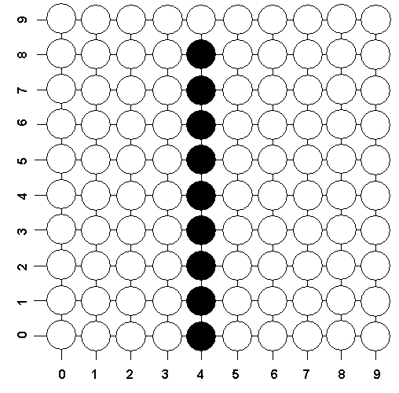
Vertical Line Drawing Algorithm
The screen coordinates of the points on a Vertical Line are obtained by keeping the value of x constant and repeatedly incrementing the y value by one unit.
a vertical line with starting point (4,0) and ending point (4,8) on a pixel based display.

Slide 3
Vertical Line Drawing Algorithm
The following code can be used to draw a vertical line from (X, Ystart) to (X, Yend),
where Ystart ≤ Yend
x = X
y = Ystart
Next: Set pixel (x, y) with desired color
y = y+ 1
If y ≤ Yend then go to Next
End

Slide 4
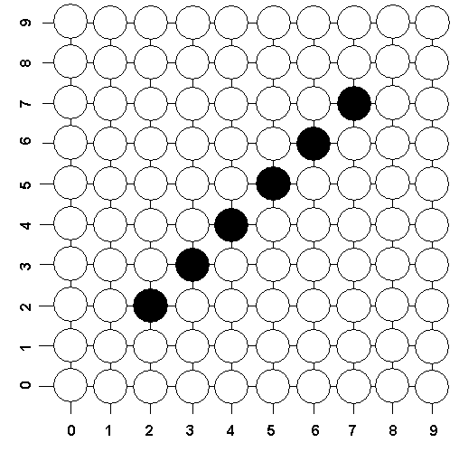
Diagonal Line Drawing Algorithm (m=1)
To draw a diagonal line with a slope equals +1 (m=1), we need only repeatedly increment by one unit both the x and y values from the starting to the ending pixels.
a diagonal line (m=1) with starting point (2,2) and ending point (7,7) on a pixel based display

Slide 5
Diagonal Line Drawing Algorithm (m=1)
The following code can be used to draw a diagonal line from (Xstart, Ystart) to (Xend, Yend), where Xstart ≤ Xend and Ystart ≤ Yend
x = Xstart
y = Ystart
Next: Set pixel (x, y) with desired color
y = y+ 1
x = x + 1
If x ≤ Xend then go to Next
End

Slide 6
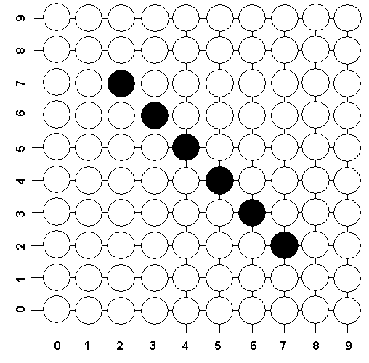
Diagonal Line Drawing Algorithm (m=-1)
To draw a diagonal line with a slope equals –1 (m=-1), we need only repeatedly increment by one unit the x and decrementing by one unit the y values from the starting to the ending pixels.
a diagonal line (m=-1) with starting point (2,7) and ending point (7,2) on a pixel based display.

Slide 7
Diagonal Line Drawing Algorithm (m=-1)
The following code can be used to draw a diagonal line from (Xstart, Ystart) to (Xend, Yend), where Xstart ≤ Xend and Ystart ≥ Yend
x = Xstart
y = Ystart
Next: Set pixel (x, y) with desired color
y = y – 1
x = x + 1
If x ≤ Xend then go to Next
End

